Slide 1

COURSE SLIDES
AWS Certified Data Engineer Associate Training
WSQ Course Code: TGS-2025053209 Conducted by Tertiary Infotech Academy Pte Ltd | UEN 201200696W
Version 1
AWS Certified Data Engineer Associate Training | TGS-2025053209
(c) 2026 Tertiary Infotech Academy Pte Ltd
1

Slide 2
YOUR TRAINER - GENERAL
About the Trainer
NAME
?
TITLE / DESIGNATION
QUALIFICATIONS
Your Trainer
AREAS OF EXPERTISE
General Trainer template - to be completed by the trainer
TRAINING & INDUSTRY EXPERIENCE
CONTACT
AWS Certified Data Engineer Associate Training | TGS-2025053209
(c) 2026 Tertiary Infotech Academy Pte Ltd
2

Slide 3
YOUR TRAINER
About the Trainer
ROLE
Principal Trainer, Tertiary Infotech Academy Pte. Ltd.
AA
QUALIFICATIONS
PhD - specialises in AI, automation and software engineering.
DELIVERS
Dr. Alfred Ang
WSQ courses on cloud, data engineering, automation and app development.
Principal Trainer Tertiary Infotech Academy Pte. Ltd.
FOUNDER
Founder and lead instructor at Tertiary Infotech / Tertiary Courses.
AWS Certified Data Engineer Associate Training | TGS-2025053209
(c) 2026 Tertiary Infotech Academy Pte Ltd
3

Slide 4
ADMIN
Copyright
- (c) 2026 Tertiary Infotech Academy Pte Ltd. All rights reserved.
- Course materials are for registered learners only.
- Do not redistribute without written permission.
AWS Certified Data Engineer Associate Training | TGS-2025053209
(c) 2026 Tertiary Infotech Academy Pte Ltd
4

Slide 5
2-DAY COURSE FLOW
Agenda
- Day 1: data lake foundation, ingestion, catalog, Athena, ETL, data quality, modeling.
- Day 2: orchestration, governance, security, monitoring, cost, reliability, exam review.
- Every concept maps to one or more hands-on labs.
AWS Certified Data Engineer Associate Training | TGS-2025053209
(c) 2026 Tertiary Infotech Academy Pte Ltd
5

Slide 6
LEARNING OUTCOMES
Course Objectives
- Design secure and governed AWS data pipelines.
- Select fit-for-purpose AWS data engineering services.
- Prepare for AWS Certified Data Engineer Associate exam scenarios.
AWS Certified Data Engineer Associate Training | TGS-2025053209
(c) 2026 Tertiary Infotech Academy Pte Ltd
6

Slide 7
HOUSEKEEPING
Ground Rules
1
Set your mobile phone to silent mode.
2
Participate actively - no question is too small.
3
Mutual respect: agree to disagree.
4
One conversation at a time.
5
Be punctual; return from breaks on time.
6
75% attendance is required.
AWS Certified Data Engineer Associate Training | TGS-2025053209
(c) 2026 Tertiary Infotech Academy Pte Ltd
7

Slide 8
TRAQOM
Digital Attendance
- AM, PM, and assessment attendance are mandatory.
- Scan the trainer-provided QR code.
- Minimum 75% attendance is required for funding eligibility.
AWS Certified Data Engineer Associate Training | TGS-2025053209
(c) 2026 Tertiary Infotech Academy Pte Ltd
8

Slide 9
LMS
LMS and Course Materials
- Slides, Learner Guide, labs, and assessment instructions are provided through the LMS.
- Submit required assessment responses and feedback through the LMS.
- Keep your lab evidence organized for review.
AWS Certified Data Engineer Associate Training | TGS-2025053209
(c) 2026 Tertiary Infotech Academy Pte Ltd
9

Slide 10
FINAL ASSESSMENT
Assessment
- Written/MCQ assessment and practical lab evidence.
- Assessment is aligned to the eight labs.
- Final review and weak-topic plan are completed in Lab 8.
AWS Certified Data Engineer Associate Training | TGS-2025053209
(c) 2026 Tertiary Infotech Academy Pte Ltd
10

Slide 11
ASSESSMENT
Assessment Flow Reminder
1
2
3
4
5
TRAQOM digital attendance
>
Assessment digital attendance
>
Sit WA then Case Study
>
Submit answers on the LMS
>
Sign Assessment Summary Record
The TRAQOM QR code and LMS submission are both handled through the LMS/TMS portal.
AWS Certified Data Engineer Associate Training | TGS-2025053209
(c) 2026 Tertiary Infotech Academy Pte Ltd
11

Slide 12
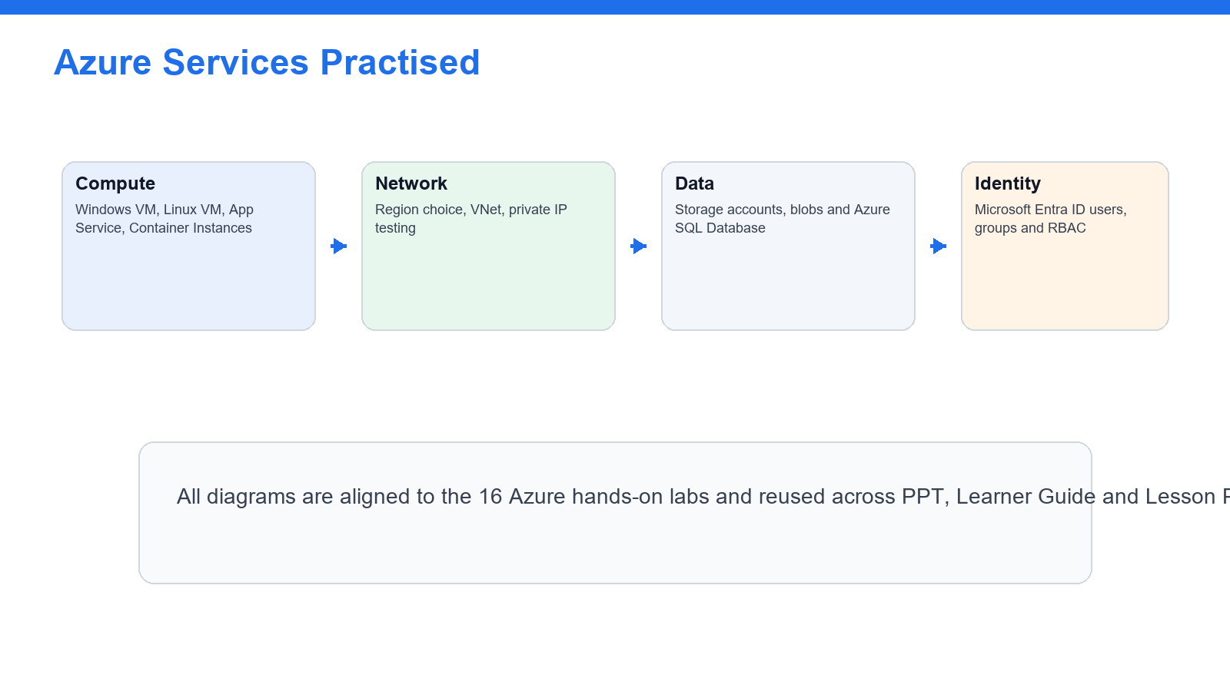
SERVICES
AWS Data Engineering Map
- Data lake: S3, IAM, KMS, Lake Formation.
- Ingestion: Kinesis, DMS, DataSync, Transfer Family, EventBridge.
- Processing and serving: Glue, Athena, Redshift, DynamoDB, OpenSearch, RDS.
AWS Certified Data Engineer Associate Training | TGS-2025053209
(c) 2026 Tertiary Infotech Academy Pte Ltd
12

Slide 13
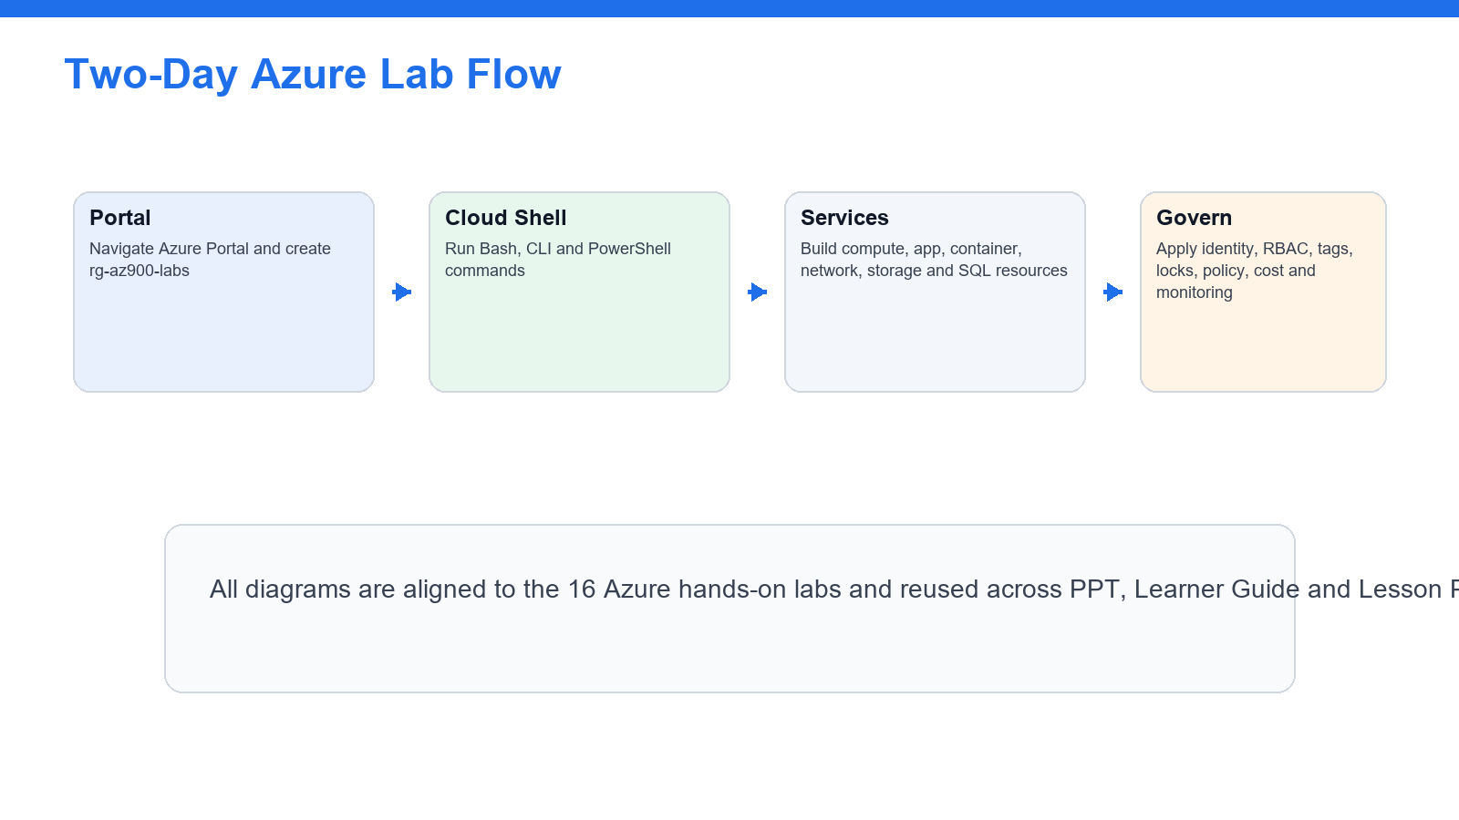
LAB ALIGNMENT
Lab Flow
- Labs progress from foundation to operations.
- Each lab produces notes, diagrams, tables, or review evidence.
- The Learner Guide mirrors the lab sequence exactly.
AWS Certified Data Engineer Associate Training | TGS-2025053209
(c) 2026 Tertiary Infotech Academy Pte Ltd
13

Slide 14
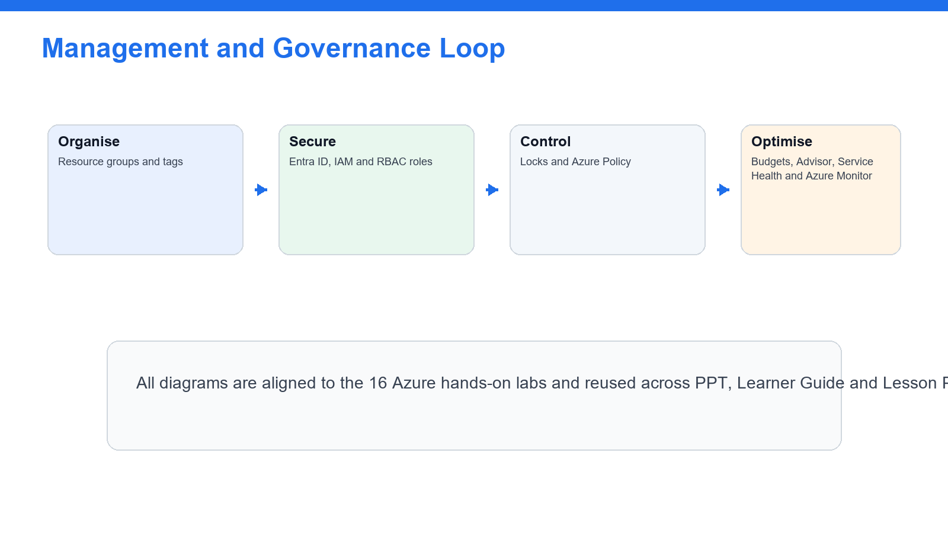
SECURITY
Governance Loop
- Design least privilege before creating resources.
- Encrypt, classify, audit, and lifecycle data.
- Governance decisions recur across all labs.
AWS Certified Data Engineer Associate Training | TGS-2025053209
(c) 2026 Tertiary Infotech Academy Pte Ltd
14

Slide 15
LAB OVERVIEW
Lab 1: Account Safety, IAM, S3 Data Lake, and Data Formats
You are preparing an AWS data engineering workspace. The first step is to create secure access patterns and a clear S3 data lake structure.
- Configure a safe AWS learning baseline.
- Review IAM roles, policies, and least privilege for data workloads.
- Create an S3 data lake folder structure if permitted.
- Compare CSV, JSON, and Parquet formats.
- Evidence: IAM and least-privilege notes
- Evidence: S3 data lake prefix structure
- Evidence: Data format comparison table
- Evidence: Encryption and cost safety notes
AWS Certified Data Engineer Associate Training | TGS-2025053209
(c) 2026 Tertiary Infotech Academy Pte Ltd
15

Slide 16
LAB STEPS
Lab 1: Step-by-Step
- 1. Sign in to the AWS account assigned by your trainer.
- 2. Confirm you are in the correct region.
- 3. Open IAM and review users, groups, roles, and policies.
- 4. Verify MFA is enabled where permitted.
- 5. Review least-privilege access for S3, Glue, Athena, and KMS.
- 6. Open S3.
- 7. Create a bucket only if your trainer permits it.
- 8. Enable default encryption.
- 9. Keep Block Public Access enabled.
- 10. Create prefixes named `raw/`, `curated/`, `analytics/`, and `logs/`.
AWS Certified Data Engineer Associate Training | TGS-2025053209
(c) 2026 Tertiary Infotech Academy Pte Ltd
16

Slide 17
LAB STEPS
Lab 1: Step-by-Step (cont.)
- 11. Upload small sample CSV and JSON files to `raw/`.
- 12. Review object metadata and storage class.
- 13. Create a table comparing CSV, JSON, Parquet, and ORC.
- 14. Record which formats support efficient analytics better.
- 15. Open KMS and review customer managed key concepts.
- 16. Open Billing and confirm budget monitoring is available.
- 17. Save your notes.
AWS Certified Data Engineer Associate Training | TGS-2025053209
(c) 2026 Tertiary Infotech Academy Pte Ltd
17

Slide 18
CHECKPOINT
Lab 1: Validation
You should be able to explain how IAM, S3 prefixes, encryption, and file formats support a data lake foundation.
- IAM and least-privilege notes
- S3 data lake prefix structure
- Data format comparison table
- Encryption and cost safety notes
AWS Certified Data Engineer Associate Training | TGS-2025053209
(c) 2026 Tertiary Infotech Academy Pte Ltd
18

Slide 19
LAB OVERVIEW
Lab 2: Data Ingestion with Kinesis, DMS, Transfer, and Event Patterns
Data platforms ingest files, events, database changes, and streams. This lab focuses on choosing appropriate AWS ingestion services and designing a simple ingestion pattern.
- Compare batch, streaming, migration, and managed file transfer ingestion patterns.
- Review Kinesis, DMS, DataSync, Transfer Family, and EventBridge.
- Design an ingestion flow for common data sources.
- Identify operational and cost considerations.
- Evidence: Ingestion service comparison table
- Evidence: Batch ingestion architecture notes
- Evidence: Streaming ingestion architecture notes
- Evidence: Monitoring and cost considerations
AWS Certified Data Engineer Associate Training | TGS-2025053209
(c) 2026 Tertiary Infotech Academy Pte Ltd
19

Slide 20
LAB STEPS
Lab 2: Step-by-Step
- 1. Open the Kinesis console.
- 2. Review Data Streams, Data Firehose, and Managed Service for Apache Flink use cases.
- 3. Record the difference between stream capture, delivery, and stream processing.
- 4. Open AWS Database Migration Service.
- 5. Review source, target, replication instance, and change data capture concepts.
- 6. Open AWS DataSync.
- 7. Review file migration and transfer use cases.
- 8. Open AWS Transfer Family.
- 9. Review SFTP, FTPS, and FTP managed transfer use cases.
- 10. Open EventBridge.
AWS Certified Data Engineer Associate Training | TGS-2025053209
(c) 2026 Tertiary Infotech Academy Pte Ltd
20

Slide 21
LAB STEPS
Lab 2: Step-by-Step (cont.)
- 11. Review event bus, rule, schedule, and target concepts.
- 12. Create an ingestion pattern table for batch files, streaming events, database migration, CDC, managed file transfer, and scheduled events.
- 13. Draw a simple architecture for ingesting daily CSV files into S3 and cataloging them.
- 14. Draw a second architecture for streaming click events into S3 or analytics.
- 15. Identify monitoring points for each architecture.
- 16. Save your notes.
AWS Certified Data Engineer Associate Training | TGS-2025053209
(c) 2026 Tertiary Infotech Academy Pte Ltd
21

Slide 22
CHECKPOINT
Lab 2: Validation
You should be able to select ingestion services for common batch, streaming, migration, and file-transfer scenarios.
- Ingestion service comparison table
- Batch ingestion architecture notes
- Streaming ingestion architecture notes
- Monitoring and cost considerations
AWS Certified Data Engineer Associate Training | TGS-2025053209
(c) 2026 Tertiary Infotech Academy Pte Ltd
22

Slide 23
LAB OVERVIEW
Lab 3: Glue Data Catalog, Crawlers, Athena, and Schema Discovery
A data lake needs searchable metadata before analysts and pipelines can query it. You will catalog sample data and run basic SQL with Athena.
- Create or review a Glue Data Catalog database.
- Use crawlers to discover schema if permitted.
- Query cataloged data with Athena.
- Understand partitions and schema evolution.
- Evidence: Glue database and crawler notes
- Evidence: Catalog table screenshot or schema notes
- Evidence: Athena SQL snippets
- Evidence: Partition and query-cost notes
AWS Certified Data Engineer Associate Training | TGS-2025053209
(c) 2026 Tertiary Infotech Academy Pte Ltd
23

Slide 24
LAB STEPS
Lab 3: Step-by-Step
- 1. Open AWS Glue.
- 2. Open Data Catalog databases.
- 3. Create a database only if your trainer permits it.
- 4. Review tables, columns, partitions, and schema metadata.
- 5. Open Crawlers.
- 6. Create a crawler for the S3 `raw/` prefix if permitted.
- 7. Assign or review the crawler IAM role.
- 8. Run the crawler.
- 9. Review the created table schema.
- 10. Open Athena.
AWS Certified Data Engineer Associate Training | TGS-2025053209
(c) 2026 Tertiary Infotech Academy Pte Ltd
24

Slide 25
LAB STEPS
Lab 3: Step-by-Step (cont.)
- 11. Configure a query result location in S3 if required.
- 12. Select the Glue database.
- 13. Run a simple `SELECT *` query with a limit.
- 14. Run a count or group-by query.
- 15. Review query cost awareness based on scanned data.
- 16. Review how partitions reduce scanned data.
- 17. Add notes about schema evolution and crawler recrawls.
- 18. Save SQL snippets and screenshots.
AWS Certified Data Engineer Associate Training | TGS-2025053209
(c) 2026 Tertiary Infotech Academy Pte Ltd
25

Slide 26
CHECKPOINT
Lab 3: Validation
You should be able to explain how Glue Data Catalog and Athena support data discovery and serverless querying.
- Glue database and crawler notes
- Catalog table screenshot or schema notes
- Athena SQL snippets
- Partition and query-cost notes
AWS Certified Data Engineer Associate Training | TGS-2025053209
(c) 2026 Tertiary Infotech Academy Pte Ltd
26

Slide 27
LAB OVERVIEW
Lab 4: Glue ETL, Data Quality, and Data Transformation
Raw data often needs cleaning, validation, transformation, and conversion to analytics-friendly formats. You will design or run a small ETL workflow.
- Review Glue ETL job concepts.
- Design a transform from raw to curated data.
- Understand PySpark and visual ETL options.
- Add data quality checks and output-format decisions.
- Evidence: ETL design notes or job screenshot
- Evidence: Raw-to-curated transformation checklist
- Evidence: Data quality rule list
- Evidence: Output format decision notes
AWS Certified Data Engineer Associate Training | TGS-2025053209
(c) 2026 Tertiary Infotech Academy Pte Ltd
27

Slide 28
LAB STEPS
Lab 4: Step-by-Step
- 1. Open AWS Glue ETL jobs.
- 2. Review visual ETL and script-based job options.
- 3. Create a job only if your trainer permits it.
- 4. Select S3 raw data as the source.
- 5. Choose a transform such as select fields, rename fields, drop nulls, or cast data types.
- 6. Choose S3 curated data as the target.
- 7. Select Parquet as the output format if assigned.
- 8. Review job parameters, worker type, bookmarks, retries, and logging.
- 9. Run the job only if permitted.
- 10. Open the target S3 prefix and review output files.
AWS Certified Data Engineer Associate Training | TGS-2025053209
(c) 2026 Tertiary Infotech Academy Pte Ltd
28

Slide 29
LAB STEPS
Lab 4: Step-by-Step (cont.)
- 11. Open CloudWatch logs for job output.
- 12. Review AWS Glue Data Quality concepts.
- 13. Define quality rules such as non-null primary key, valid date format, row count threshold, or allowed value set.
- 14. Create a data quality checklist for the sample dataset.
- 15. Record when to use Glue, EMR, Lambda, or Athena CTAS for transformations.
- 16. Save your notes.
AWS Certified Data Engineer Associate Training | TGS-2025053209
(c) 2026 Tertiary Infotech Academy Pte Ltd
29

Slide 30
CHECKPOINT
Lab 4: Validation
You should be able to describe how Glue ETL transforms and validates data before analytics consumption.
- ETL design notes or job screenshot
- Raw-to-curated transformation checklist
- Data quality rule list
- Output format decision notes
AWS Certified Data Engineer Associate Training | TGS-2025053209
(c) 2026 Tertiary Infotech Academy Pte Ltd
30

Slide 31
LAB OVERVIEW
Lab 5: Data Modeling with Redshift, DynamoDB, OpenSearch, and RDS
Data engineers must choose storage and serving layers based on access patterns, scale, latency, and analytics requirements. This lab focuses on service selection and modeling tradeoffs.
- Compare data modeling choices across AWS services.
- Review Redshift, DynamoDB, OpenSearch, and RDS use cases.
- Understand keys, distribution, sorting, indexing, and query patterns at a high level.
- Match workload requirements to the right data store.
- Evidence: Data service selection table
- Evidence: Sample Redshift model notes
- Evidence: Sample DynamoDB key design notes
- Evidence: OpenSearch indexing notes
AWS Certified Data Engineer Associate Training | TGS-2025053209
(c) 2026 Tertiary Infotech Academy Pte Ltd
31

Slide 32
LAB STEPS
Lab 5: Step-by-Step
- 1. Open Amazon Redshift.
- 2. Review cluster, serverless, database, schema, table, distribution, and sort key concepts.
- 3. Open DynamoDB.
- 4. Review table, partition key, sort key, item, global secondary index, and capacity concepts.
- 5. Open Amazon OpenSearch Service.
- 6. Review search and log analytics use cases.
- 7. Open Amazon RDS.
- 8. Review relational database use cases and managed backups.
- 9. Create a use-case table for warehouse analytics, operational NoSQL, search analytics, and relational applications.
- 10. For a sample order dataset, identify candidate Redshift fact and dimension tables.
AWS Certified Data Engineer Associate Training | TGS-2025053209
(c) 2026 Tertiary Infotech Academy Pte Ltd
32

Slide 33
LAB STEPS
Lab 5: Step-by-Step (cont.)
- 11. For a sample event lookup workload, identify a DynamoDB partition key and optional sort key.
- 12. For a document search workload, identify indexed fields for OpenSearch.
- 13. Record high-level backup, scaling, and security considerations for each service.
- 14. Save your notes.
AWS Certified Data Engineer Associate Training | TGS-2025053209
(c) 2026 Tertiary Infotech Academy Pte Ltd
33

Slide 34
CHECKPOINT
Lab 5: Validation
You should be able to match data stores and modeling choices to query patterns and business requirements.
- Data service selection table
- Sample Redshift model notes
- Sample DynamoDB key design notes
- OpenSearch indexing notes
AWS Certified Data Engineer Associate Training | TGS-2025053209
(c) 2026 Tertiary Infotech Academy Pte Ltd
34

Slide 35
LAB OVERVIEW
Lab 6: Pipeline Orchestration with Step Functions, MWAA, and EventBridge
Data pipelines need scheduling, sequencing, dependency management, error handling, and monitoring. This lab teaches orchestration design patterns.
- Understand orchestration and scheduling choices.
- Compare Step Functions, MWAA, Glue Workflows, and EventBridge.
- Design pipeline dependencies, retries, and failure handling.
- Create a simple workflow diagram.
- Evidence: Orchestration service comparison table
- Evidence: Daily pipeline design
- Evidence: Retry and failure-handling notes
- Evidence: Monitoring points
AWS Certified Data Engineer Associate Training | TGS-2025053209
(c) 2026 Tertiary Infotech Academy Pte Ltd
35

Slide 36
LAB STEPS
Lab 6: Step-by-Step
- 1. Open AWS Step Functions.
- 2. Review state machines, tasks, choices, retries, catches, and executions.
- 3. Open Amazon Managed Workflows for Apache Airflow.
- 4. Review DAG, task, dependency, and environment concepts.
- 5. Open AWS Glue Workflows if available.
- 6. Review job and crawler orchestration.
- 7. Open EventBridge.
- 8. Review rules, schedules, events, and targets.
- 9. Create a comparison table for Step Functions, MWAA, Glue Workflows, and EventBridge.
- 10. Design a daily pipeline with steps for ingest, crawl, transform, quality check, query validation, and notification.
AWS Certified Data Engineer Associate Training | TGS-2025053209
(c) 2026 Tertiary Infotech Academy Pte Ltd
36

Slide 37
LAB STEPS
Lab 6: Step-by-Step (cont.)
- 11. Add retry and failure paths to the design.
- 12. Identify which service would trigger each step.
- 13. Identify which metrics or logs should be monitored.
- 14. Create a simple architecture diagram in your notes.
- 15. Save your design.
AWS Certified Data Engineer Associate Training | TGS-2025053209
(c) 2026 Tertiary Infotech Academy Pte Ltd
37

Slide 38
CHECKPOINT
Lab 6: Validation
You should be able to design a simple data pipeline orchestration flow and justify the orchestration service choice.
- Orchestration service comparison table
- Daily pipeline design
- Retry and failure-handling notes
- Monitoring points
AWS Certified Data Engineer Associate Training | TGS-2025053209
(c) 2026 Tertiary Infotech Academy Pte Ltd
38

Slide 39
LAB OVERVIEW
Lab 7: Security, Governance, Lake Formation, KMS, and Data Lifecycle
Data engineering work must protect sensitive data, control access, encrypt assets, and manage data lifecycle. This lab focuses on governance and security service choices.
- Review data security controls for AWS data platforms.
- Understand Lake Formation permissions.
- Review KMS encryption and key policies.
- Apply lifecycle, retention, and data governance concepts.
- Evidence: Data governance service table
- Evidence: Lake Formation permission notes
- Evidence: KMS encryption notes
- Evidence: Lifecycle and retention design
AWS Certified Data Engineer Associate Training | TGS-2025053209
(c) 2026 Tertiary Infotech Academy Pte Ltd
39

Slide 40
LAB STEPS
Lab 7: Step-by-Step
- 1. Open IAM and review least-privilege roles for Glue, Athena, S3, and Lake Formation.
- 2. Open S3 and review bucket policies, access points, object ownership, and encryption.
- 3. Open KMS and review AWS managed keys and customer managed keys.
- 4. Review key policies and grants at a high level.
- 5. Open Lake Formation.
- 6. Review data lake administrators, databases, tables, permissions, and tag-based access control.
- 7. Review how Lake Formation differs from only using IAM and S3 bucket policies.
- 8. Create a governance table covering IAM, S3 policies, KMS, Lake Formation, CloudTrail, and Macie.
- 9. Open Amazon Macie if available and review sensitive data discovery use cases.
- 10. Review S3 lifecycle rules.
AWS Certified Data Engineer Associate Training | TGS-2025053209
(c) 2026 Tertiary Infotech Academy Pte Ltd
40

Slide 41
LAB STEPS
Lab 7: Step-by-Step (cont.)
- 11. Design lifecycle transitions for raw, curated, analytics, and archive data zones.
- 12. Define retention and deletion rules for a sample dataset.
- 13. Review CloudTrail auditing for data access changes.
- 14. Save your notes.
AWS Certified Data Engineer Associate Training | TGS-2025053209
(c) 2026 Tertiary Infotech Academy Pte Ltd
41

Slide 42
CHECKPOINT
Lab 7: Validation
You should be able to explain how IAM, S3, KMS, Lake Formation, Macie, lifecycle rules, and audit logs protect data platforms.
- Data governance service table
- Lake Formation permission notes
- KMS encryption notes
- Lifecycle and retention design
AWS Certified Data Engineer Associate Training | TGS-2025053209
(c) 2026 Tertiary Infotech Academy Pte Ltd
42

Slide 43
LAB OVERVIEW
Lab 8: Monitoring, Cost Optimization, Reliability, and Exam Review
The final lab ties together operations, reliability, cost, and exam readiness for AWS data engineering workloads.
- Design monitoring for data pipelines.
- Review cost optimization and reliability patterns.
- Create an exam-domain revision map.
- Complete timed certification-style practice.
- Evidence: Monitoring plan
- Evidence: Cost optimization checklist
- Evidence: Reliability checklist
- Evidence: Timed practice score
- Evidence: Weak-topic revision plan
AWS Certified Data Engineer Associate Training | TGS-2025053209
(c) 2026 Tertiary Infotech Academy Pte Ltd
43

Slide 44
LAB STEPS
Lab 8: Step-by-Step
- 1. Open CloudWatch.
- 2. Review metrics, logs, alarms, and dashboards.
- 3. Identify monitoring points for S3, Glue, Athena, Kinesis, Step Functions, and Redshift.
- 4. Open CloudTrail and review audit event concepts.
- 5. Open AWS Budgets and Cost Explorer.
- 6. Create a cost-control checklist for data pipelines.
- 7. Review cost drivers such as scanned data, ETL worker runtime, storage class, stream shard count, and warehouse capacity.
- 8. Create a reliability checklist covering retries, idempotency, dead-letter queues, partitioning, backup, and disaster recovery.
- 9. Review exam domains and map each lab to one or more domains.
- 10. Complete a timed 30-question practice set from trainer-provided questions or AWS practice resources.
AWS Certified Data Engineer Associate Training | TGS-2025053209
(c) 2026 Tertiary Infotech Academy Pte Ltd
44

Slide 45
LAB STEPS
Lab 8: Step-by-Step (cont.)
- 11. Mark weak topics by domain.
- 12. Create a final revision plan.
- 13. Clean up temporary resources if instructed.
- 14. Save final notes.
AWS Certified Data Engineer Associate Training | TGS-2025053209
(c) 2026 Tertiary Infotech Academy Pte Ltd
45

Slide 46
CHECKPOINT
Lab 8: Validation
You should be ready to explain AWS data engineering services, pipeline patterns, governance, operations, and exam-style scenario choices.
- Monitoring plan
- Cost optimization checklist
- Reliability checklist
- Timed practice score
- Weak-topic revision plan
AWS Certified Data Engineer Associate Training | TGS-2025053209
(c) 2026 Tertiary Infotech Academy Pte Ltd
46

Slide 47
CERTIFICATION
Exam Review Map
- Map weak questions back to the lab that covered the service.
- Prioritize scenario words: latency, cost, governance, throughput, retention.
- Use Lab 8 to turn mistakes into a revision plan.
AWS Certified Data Engineer Associate Training | TGS-2025053209
(c) 2026 Tertiary Infotech Academy Pte Ltd
47

Slide 48
PRACTICE EXAM
Take the Online AWS DEA Practice Exams
- Reinforce AWS data engineering domains with realistic, exam-style questions before assessment day.
- Use practice sets to test ingestion, transformation, orchestration, governance and operations.
- Review mode helps you check the correct answer and revisit the concept after each question.
- Complete the practice questions from Google Classroom, then bring difficult items to the review session.
T
Tertiary Exams
Practice Exam
AWS Certified Data Engineer Associate Practice Exams
MODE
FOCUS
ACCESS
Practice
DEA-C01
Class link
Data Ingestion
34%
Transform & Optimize
26%
Orchestration
22%
Access and practise at:
Security & Governance
18%
Google Classroom > Practice Exams
AWS Certified Data Engineer Associate Training | TGS-2025053209
(c) 2026 Tertiary Infotech Academy Pte Ltd
48

Slide 49
BEFORE YOU GO
Certification and TRAQOM Survey
- Complete final attendance and TRAQOM survey.
- Confirm assessment submission on the LMS.
- Delete temporary AWS resources and keep budget alerts active.
AWS Certified Data Engineer Associate Training | TGS-2025053209
(c) 2026 Tertiary Infotech Academy Pte Ltd
49

Slide 50
END
Thank You
- Questions and recap.
- Continue practicing with AWS documentation and exam-style scenarios.
- Keep the lab guide as your revision checklist.
AWS Certified Data Engineer Associate Training | TGS-2025053209
(c) 2026 Tertiary Infotech Academy Pte Ltd
50

